Slide 1
BIEN 401 Biomedical Mass Transport Class 1 Intro and Material Balances
notes prepared by
Dr. Louis Reis
Created on 3/2/2022
Revised on 3/12/2024

Slide 2
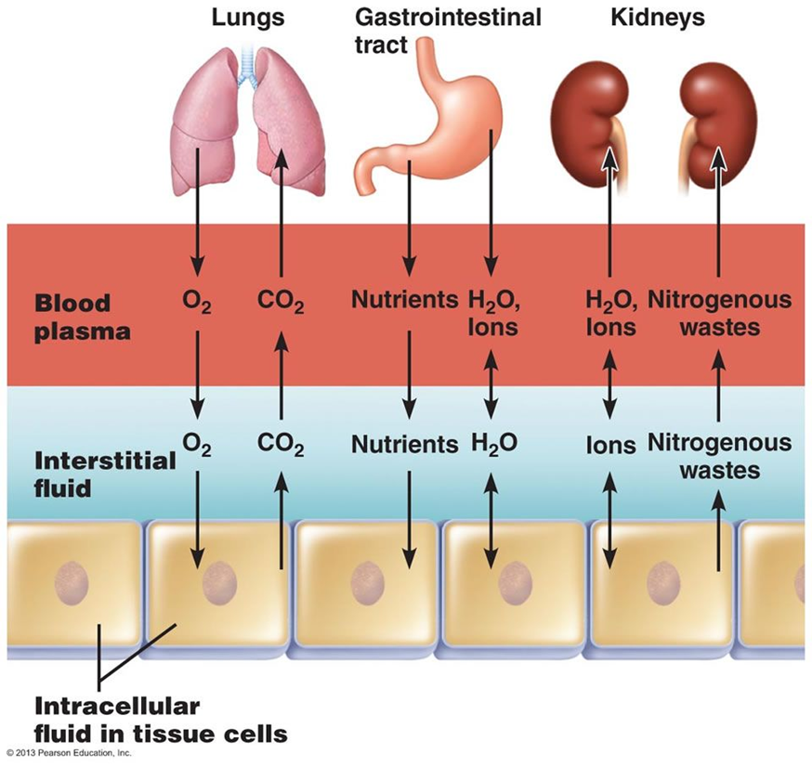
Role of Transport in Biomedical Processes
Many processes occur across all levels of biological organization (cells, tissues, organs, organism, etc.) involve transport of nutrients, wastes, and other solute molecules
Examples:
Gas exchange between lungs and pulmonary capillaries
Nutrient/waste exchange in capillary beds
Cell potentials
Organ systems where mass transport is the primary or major function
Circulatory (transport of blood, nutrients, wastes, etc.)
Respiratory (gas exchange)
Digestive (nutrient intake)
Exocrine (waste removal)

Slide 3
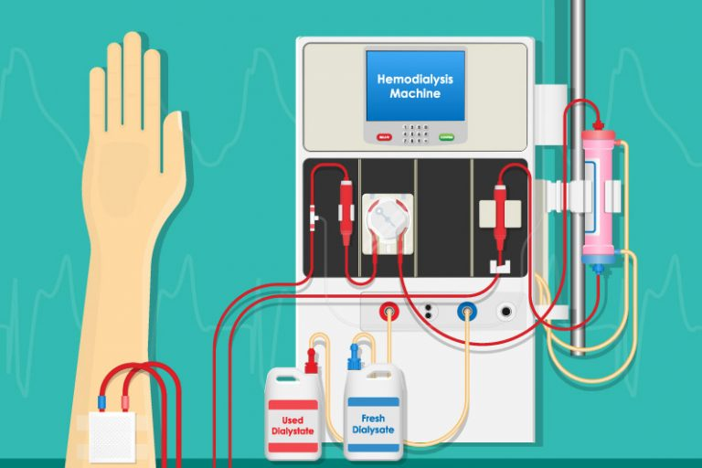
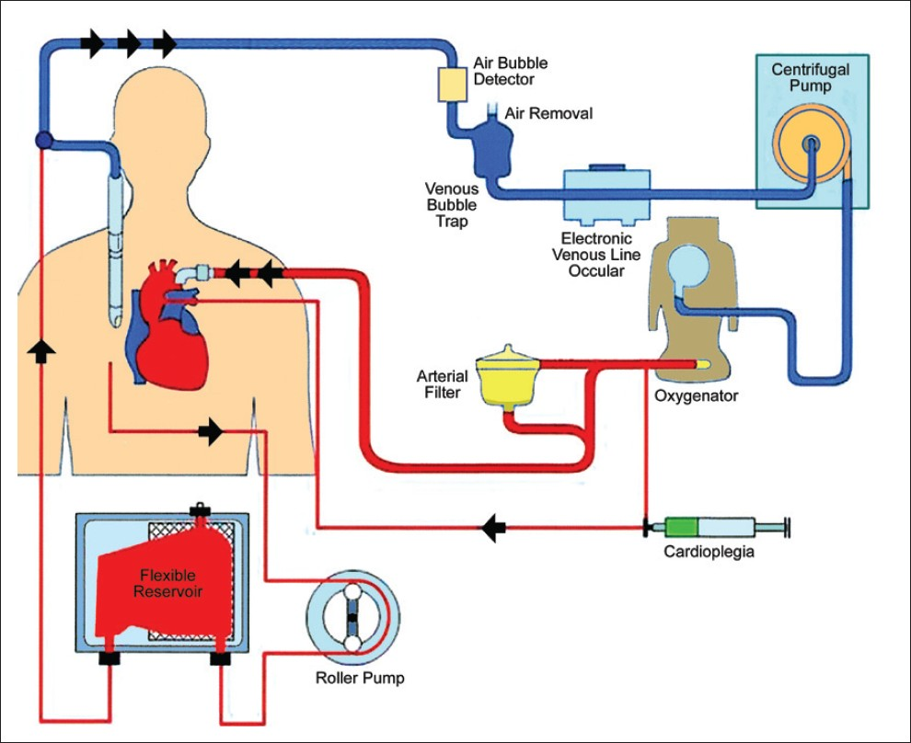
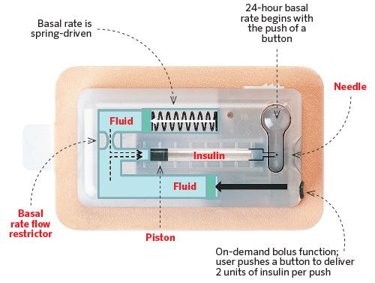
Role of Transport in Biomedical Processes
As biomedical engineers, understanding these processes allow us to develop unique solutions to address deficiencies in transport in diseased organs
Examples:
Dialysis machine
Heart-lung bypass
Membrane oxygenators
Insulin pumps
Biomedical sensors

Slide 4
Mass Transport
There are two major mechanisms by which mass movement occurs:
Diffusion
Random motion of molecules due to thermal energy transferred by molecular collisions
At macroscopic level, diffusing molecules travel from high concentration zones to low concentration zones (i.e., down the concentration gradient)
Relationship between diffusive flux and concentration gradient defined by Fick’s Laws
Convection
Transport as a result of bulk fluid motion
Transport driven by gravity, pressure gradients, and/or shear forces

Slide 5
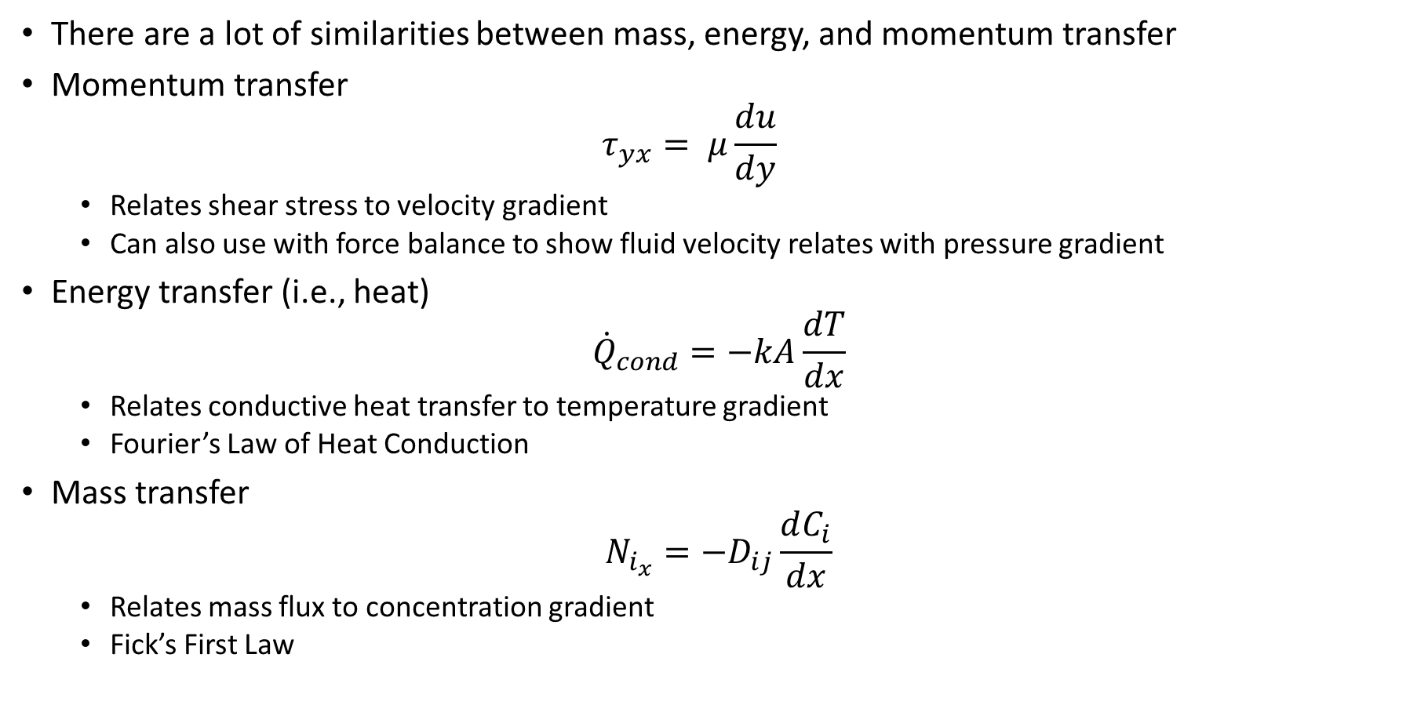
Transport Relationships
There are a lot of similarities between mass, energy, and momentum transfer
Momentum transfer
$$τ_{yx}= μ\frac{du}{dy}$$
Relates shear stress to velocity gradient
Can also use with force balance to show fluid velocity relates with pressure gradient
Energy transfer (i.e., heat)
$${\dot{Q}}_{cond}=−kA\frac{dT}{dx}$$
Relates conductive heat transfer to temperature gradient
Fourier’s Law of Heat Conduction
Mass transfer
$$N_{i_{x}}=−D_{ij}\frac{dC_{i}}{dx}$$
Relates mass flux to concentration gradient
Fick’s First Law

Slide 6
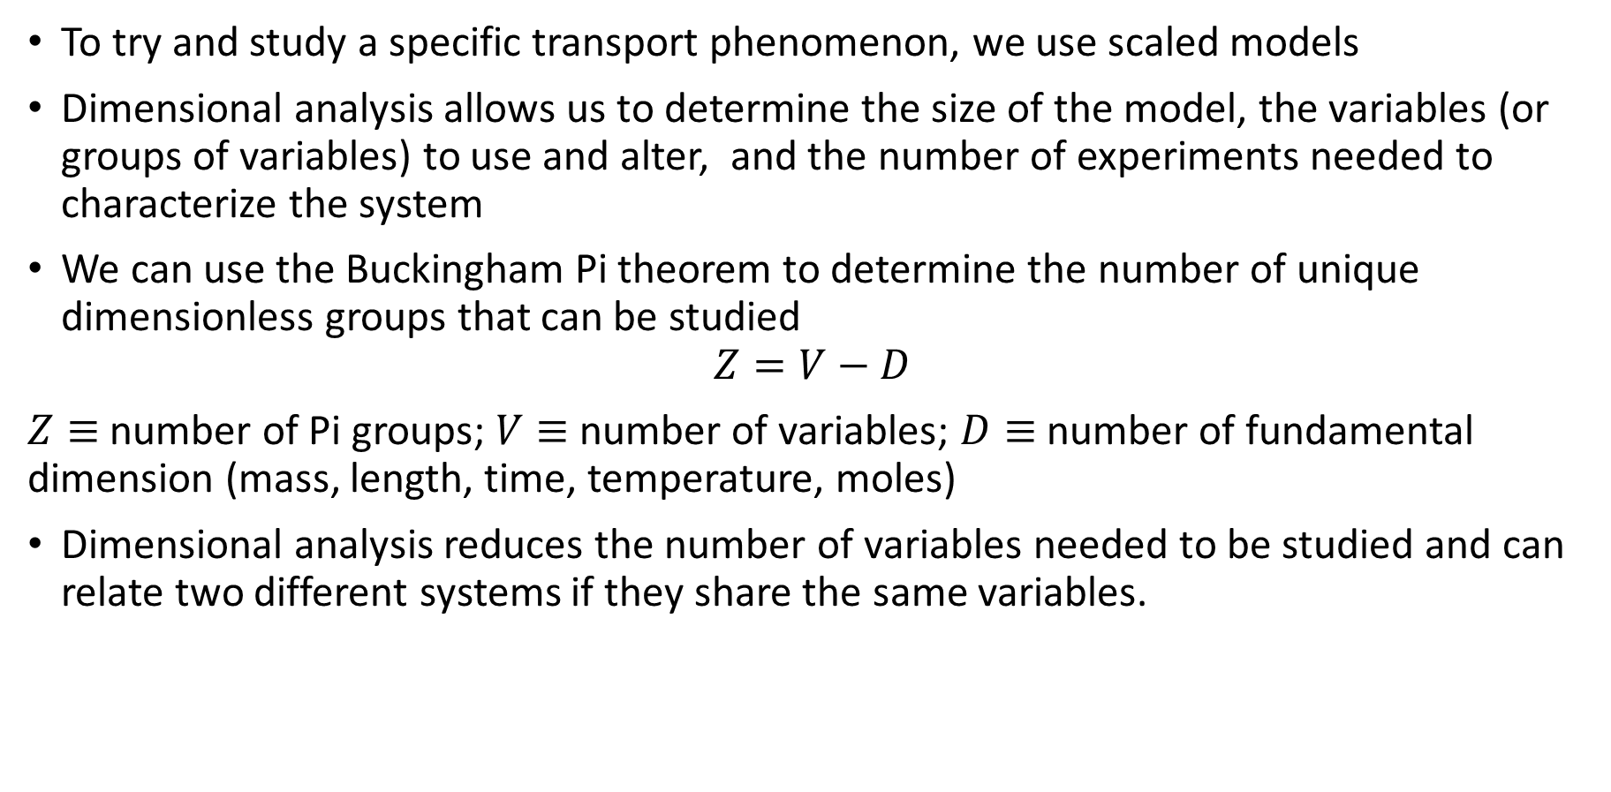
Dimensional Analysis
To try and study a specific transport phenomenon, we use scaled models
Dimensional analysis allows us to determine the size of the model, the variables (or groups of variables) to use and alter, and the number of experiments needed to characterize the system
We can use the Buckingham Pi theorem to determine the number of unique dimensionless groups that can be studied
$$Z=V−D$$
$Z≡$ number of Pi groups; $V≡$ number of variables; $D≡$ number of fundamental dimension (mass, length, time, temperature, moles)
Dimensional analysis reduces the number of variables needed to be studied and can relate two different systems if they share the same variables.

Slide 7
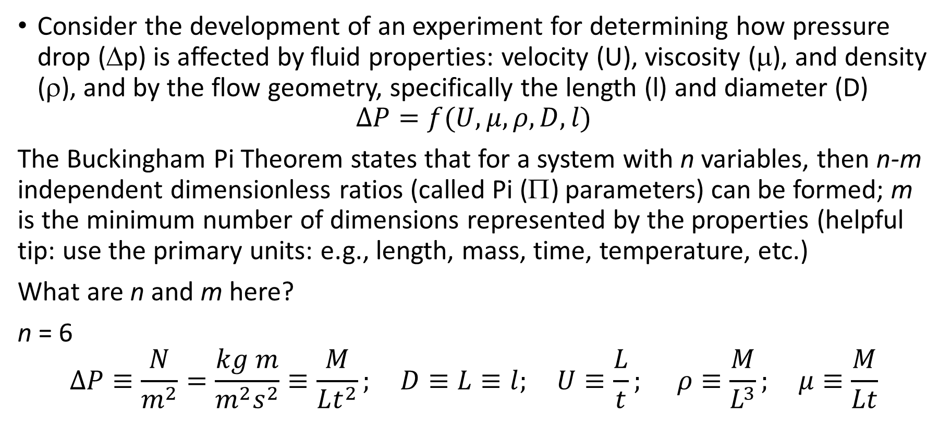
Buckingham Pi Theorem Example
Consider the development of an experiment for determining how pressure drop (Δp) is affected by fluid properties: velocity (U), viscosity (μ), and density (ρ), and by the flow geometry, specifically the length (l) and diameter (D)
$$∆P=f(U,μ,ρ, D, l)$$
The Buckingham Pi Theorem states that for a system with n variables, then n-m independent dimensionless ratios (called Pi (Π) parameters) can be formed; m is the minimum number of dimensions represented by the properties (helpful tip: use the primary units: e.g., length, mass, time, temperature, etc.)
What are n and m here?
n = 6
$$∆P≡\frac{N}{m^{2}}=\frac{kg m}{m^{2}s^{2}}≡\frac{M}{Lt^{2}}; D≡L≡l; U≡\frac{L}{t}; ρ≡\frac{M}{L^{3}}; μ≡\frac{M}{Lt}$$

Slide 8
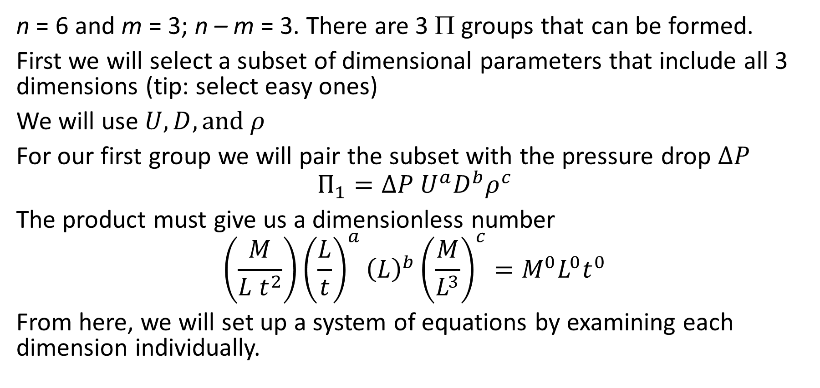
Buckingham Pi Theorem
n = 6 and m = 3; n – m = 3. There are 3 Π groups that can be formed.
First we will select a subset of dimensional parameters that include all 3 dimensions (tip: select easy ones)
We will use $U, D, \text{and} ρ$
For our first group we will pair the subset with the pressure drop $∆P$
$$Π_{1}=∆P U^{a}D^{b}ρ^{c}$$
The product must give us a dimensionless number
$$\left(\frac{M}{L t^{2}}\right){\left(\frac{L}{t}\right)}^{a}{\left(L\right)}^{b}{\left(\frac{M}{L^{3}}\right)}^{c}=M^{0}L^{0}t^{0}$$
From here, we will set up a system of equations by examining each dimension individually.

Slide 9
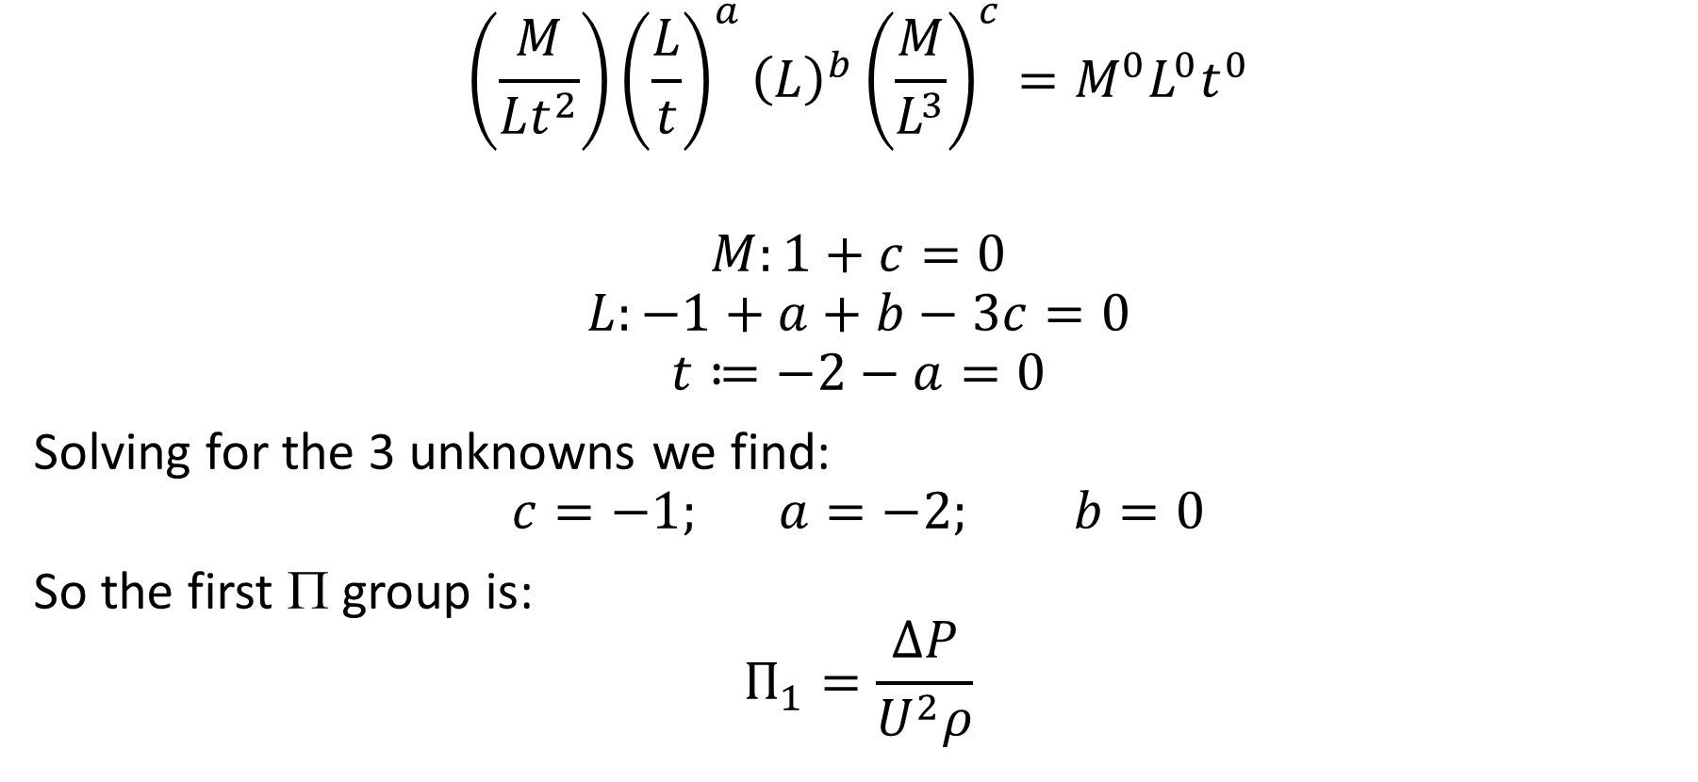
Buckingham Pi Theorem
$$\left(\frac{M}{Lt^{2}}\right){\left(\frac{L}{t}\right)}^{a}{\left(L\right)}^{b}{\left(\frac{M}{L^{3}}\right)}^{c}=M^{0}L^{0}t^{0}$$
$$M:1+c=0$$
$$L:−1+a+b−3c=0$$
$$t≔−2−a=0$$
Solving for the 3 unknowns we find:
$$c=−1; a=−2; b=0$$
So the first Π group is:
$$Π_{1}=\frac{∆P}{U^{2}ρ}$$

Slide 10
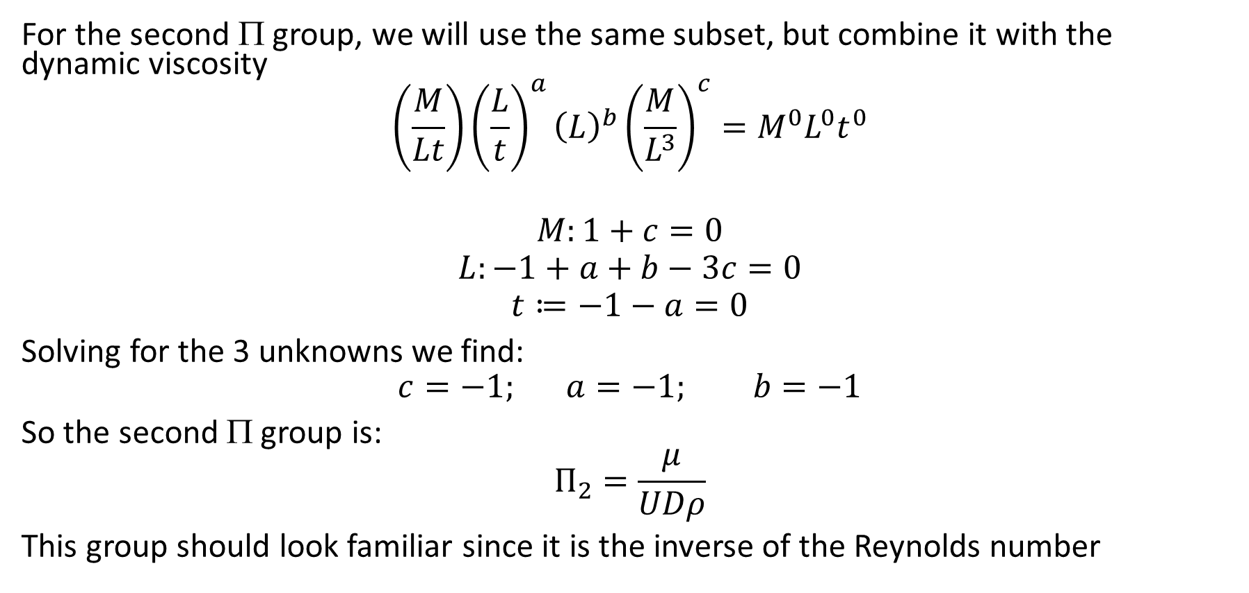
Buckingham Pi Theorem
For the second Π group, we will use the same subset, but combine it with the dynamic viscosity
$$\left(\frac{M}{Lt}\right){\left(\frac{L}{t}\right)}^{a}{\left(L\right)}^{b}{\left(\frac{M}{L^{3}}\right)}^{c}=M^{0}L^{0}t^{0}$$
$$M:1+c=0$$
$$L:−1+a+b−3c=0$$
$$t≔−1−a=0$$
Solving for the 3 unknowns we find:
$$c=−1; a=−1; b=−1$$
So the second Π group is:
$$Π_{2}=\frac{μ}{UDρ}$$
This group should look familiar since it is the inverse of the Reynolds number

Slide 11
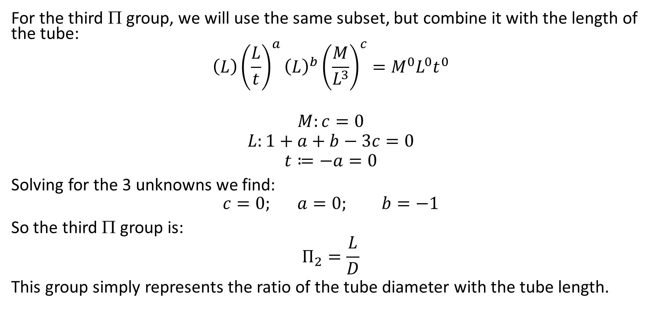
Buckingham Pi Theorem
For the third Π group, we will use the same subset, but combine it with the length of the tube:
$$\left(L\right){\left(\frac{L}{t}\right)}^{a}{\left(L\right)}^{b}{\left(\frac{M}{L^{3}}\right)}^{c}=M^{0}L^{0}t^{0}$$
$$M:c=0$$
$$L:1+a+b−3c=0$$
$$t≔−a=0$$
Solving for the 3 unknowns we find:
$$c=0; a=0; b=−1$$
So the third Π group is:
$$Π_{2}=\frac{L}{D}$$
This group simply represents the ratio of the tube diameter with the tube length.

Slide 12
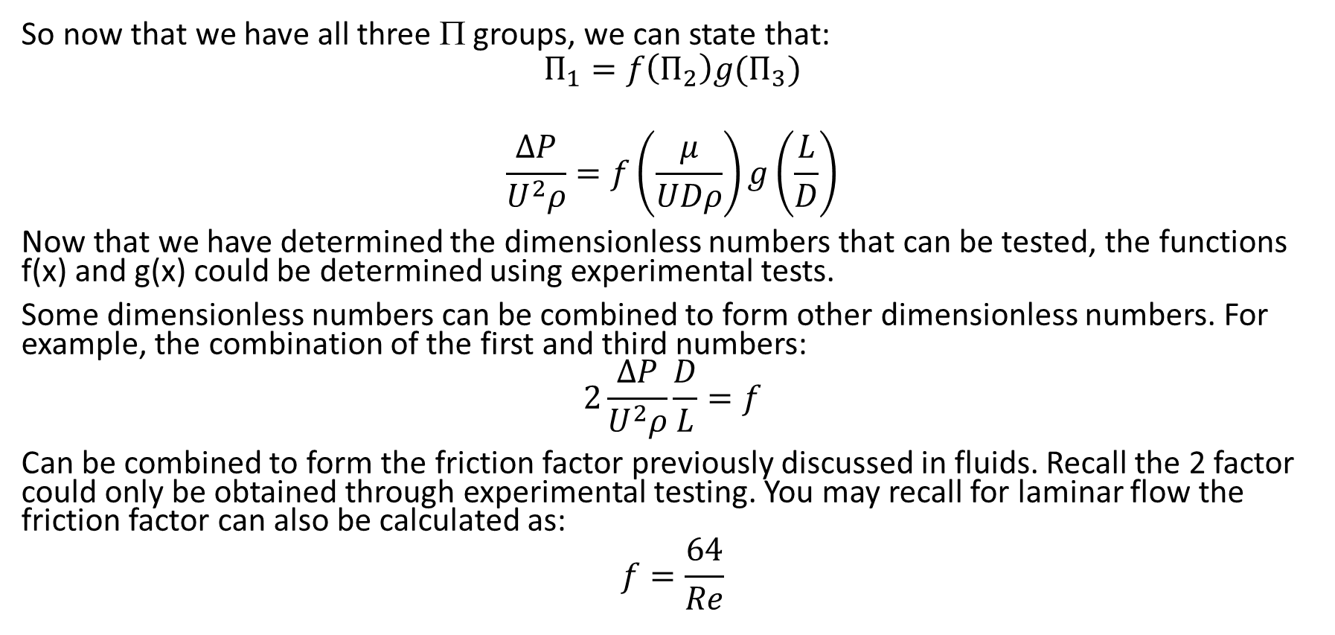
Buckingham Pi Theorem
So now that we have all three Π groups, we can state that:
$$Π_{1}=f\left(Π_{2}\right)g(Π_{3})$$
$$\frac{∆P}{U^{2}ρ}=f\left(\frac{μ}{UDρ}\right)g\left(\frac{L}{D}\right)$$
Now that we have determined the dimensionless numbers that can be tested, the functions f(x) and g(x) could be determined using experimental tests.
Some dimensionless numbers can be combined to form other dimensionless numbers. For example, the combination of the first and third numbers:
$$2\frac{∆P}{U^{2}ρ}\frac{D}{L}=f$$
Can be combined to form the friction factor previously discussed in fluids. Recall the 2 factor could only be obtained through experimental testing. You may recall for laminar flow the friction factor can also be calculated as:
$$f=\frac{64}{Re}$$

Slide 13
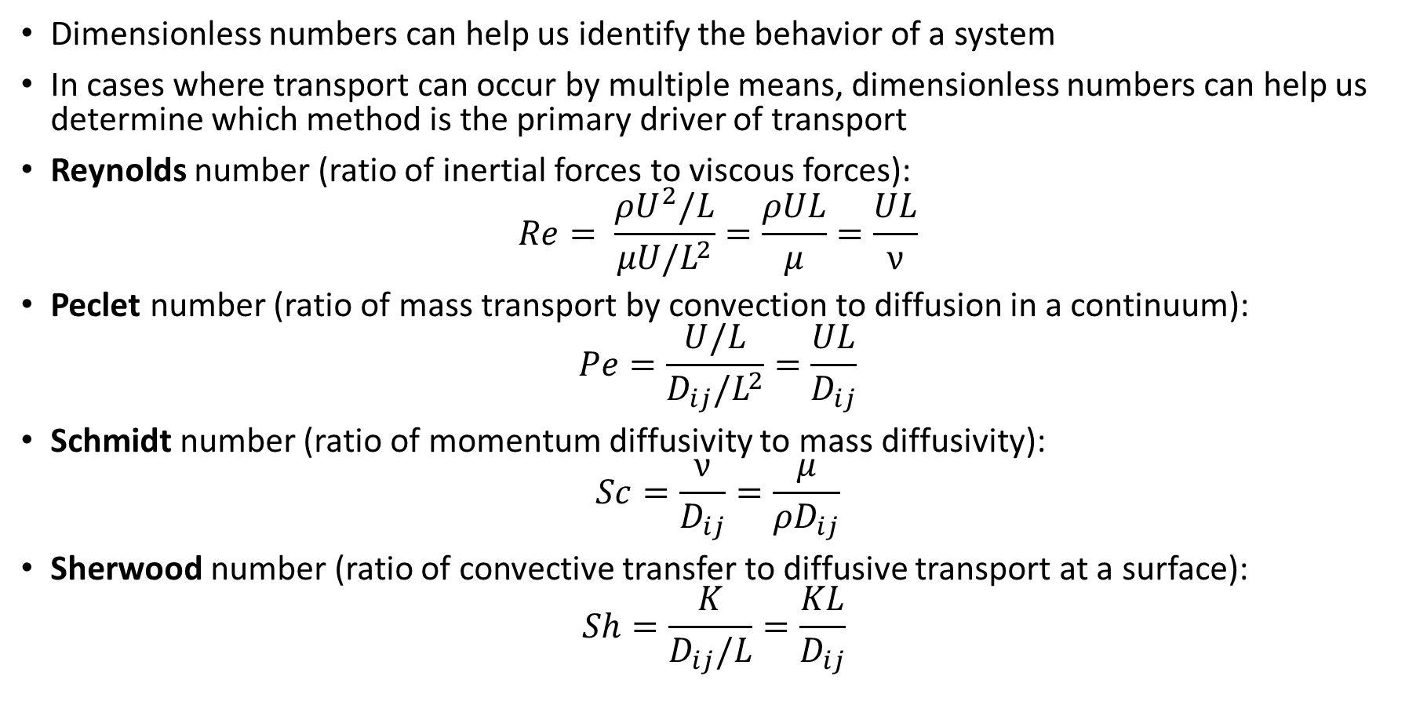
Dimensionless Numbers
Dimensionless numbers can help us identify the behavior of a system
In cases where transport can occur by multiple means, dimensionless numbers can help us determine which method is the primary driver of transport
Reynolds number (ratio of inertial forces to viscous forces):
$$Re= \frac{ρU^{2}/L}{μU/L^{2}}=\frac{ρUL}{μ}=\frac{UL}{ν}$$
Peclet number (ratio of mass transport by convection to diffusion in a continuum):
$$Pe=\frac{U/L}{D_{ij}/L^{2}}=\frac{UL}{D_{ij}}$$
Schmidt number (ratio of momentum diffusivity to mass diffusivity):
$$Sc=\frac{ν}{D_{ij}}=\frac{μ}{ρD_{ij}}$$
Sherwood number (ratio of convective transfer to diffusive transport at a surface):
$$Sh=\frac{K}{D_{ij}/L}=\frac{KL}{D_{ij}}$$

Slide 14
Dimensionless Numbers - Problem
The size (diameter d) of droplets produced by a liquid spray nozzle is thought to depend upon the nozzle diameter D, jet velocity V, and the properties of the liquid including density ρ, viscosity μ, and surface tension σ. Using the nozzle diameter D, jet velocity V, and fluid density ρ as repeating parameters, determine the number of dimensionless numbers that can be formed and what dimensionless numbers could be formed. (Hint: the SI units for surface tension are N/m; the SI units for viscosity are Pa*s.)

Slide 15
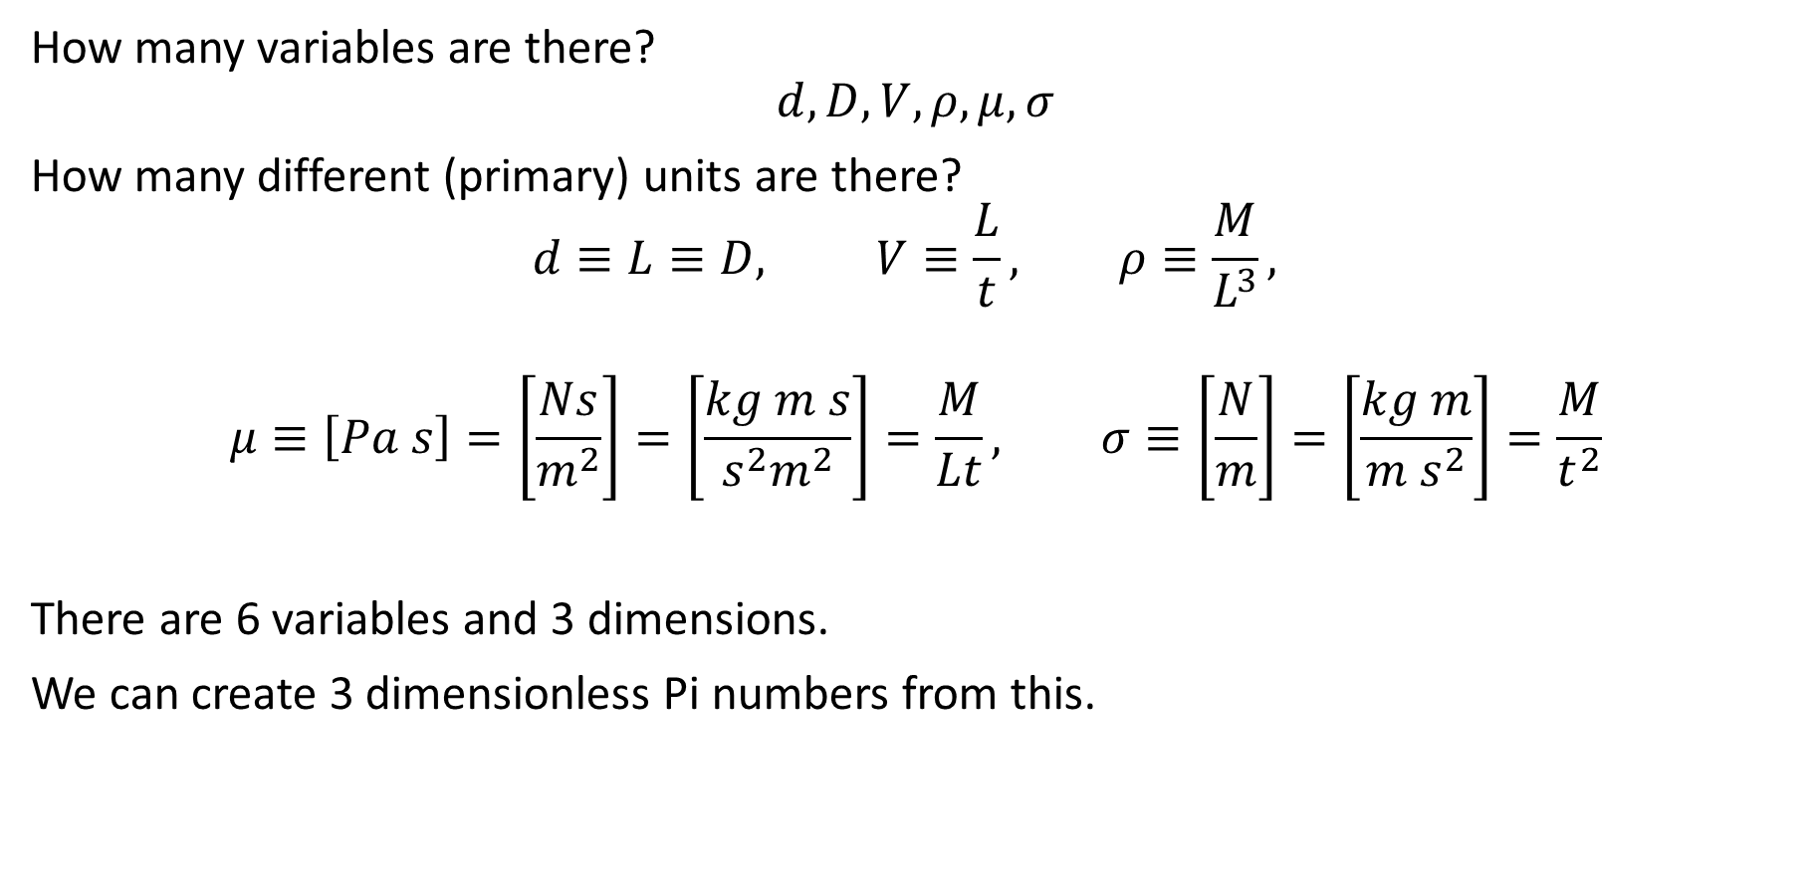
Dimensionless Numbers - Solution
How many variables are there?
$$d, D, V, ρ, μ, σ$$
How many different (primary) units are there?
$$d≡L≡D, V≡\frac{L}{t}, ρ≡\frac{M}{L^{3}},$$
$$μ≡\left[Pa s\right]=\left[\frac{Ns}{m^{2}}\right]=\left[\frac{kg m s}{s^{2}m^{2}}\right]=\frac{M}{Lt}, σ≡\left[\frac{N}{m}\right]=\left[\frac{kg m}{m s^{2}}\right]=\frac{M}{t^{2}}$$
There are 6 variables and 3 dimensions.
We can create 3 dimensionless Pi numbers from this.

Slide 16
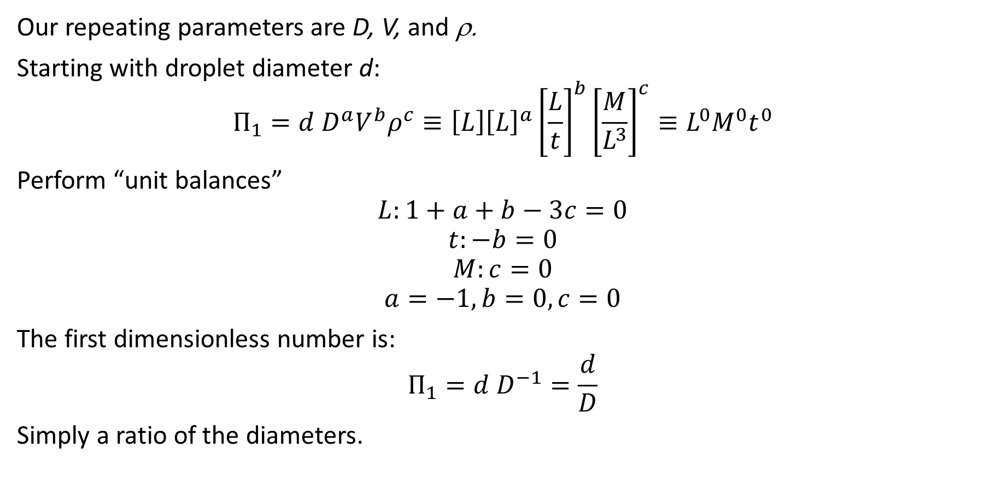
Dimensionless Numbers - Solution
Our repeating parameters are D, V, and ρ.
Starting with droplet diameter d:
$$Π_{1}=d D^{a}V^{b}ρ^{c}≡\left[L\right]{\left[L\right]}^{a}{\left[\frac{L}{t}\right]}^{b}{\left[\frac{M}{L^{3}}\right]}^{c}≡L^{0}M^{0}t^{0}$$
Perform “unit balances”
$$L:1+a+b−3c=0$$
$$t:−b=0$$
$$M:c=0$$
$$a=−1, b=0, c=0$$
The first dimensionless number is:
$$Π_{1}=d D^{−1}=\frac{d}{D}$$
Simply a ratio of the diameters.

Slide 17
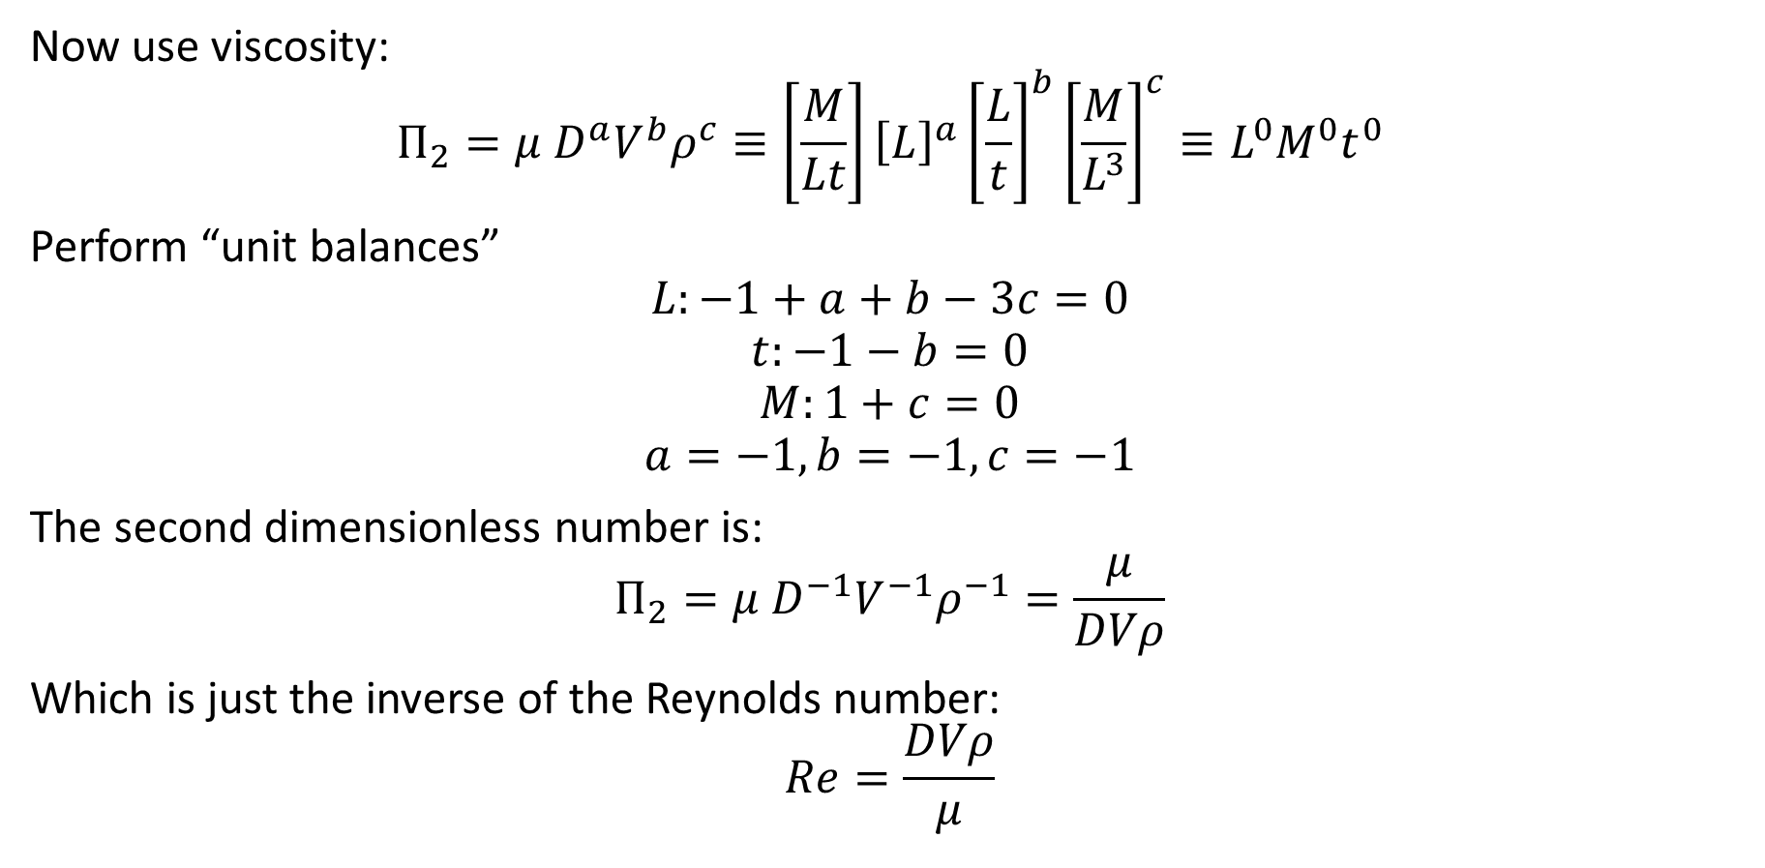
Dimensionless Numbers - Solution
Now use viscosity:
$$Π_{2}=μ D^{a}V^{b}ρ^{c}≡\left[\frac{M}{Lt}\right]{\left[L\right]}^{a}{\left[\frac{L}{t}\right]}^{b}{\left[\frac{M}{L^{3}}\right]}^{c}≡L^{0}M^{0}t^{0}$$
Perform “unit balances”
$$L:−1+a+b−3c=0$$
$$t:−1−b=0$$
$$M:1+c=0$$
$$a=−1, b=−1, c=−1$$
The second dimensionless number is:
$$Π_{2}=μ D^{−1}V^{−1}ρ^{−1}=\frac{μ}{DVρ}$$
Which is just the inverse of the Reynolds number:
$$Re=\frac{DVρ}{μ}$$

Slide 18
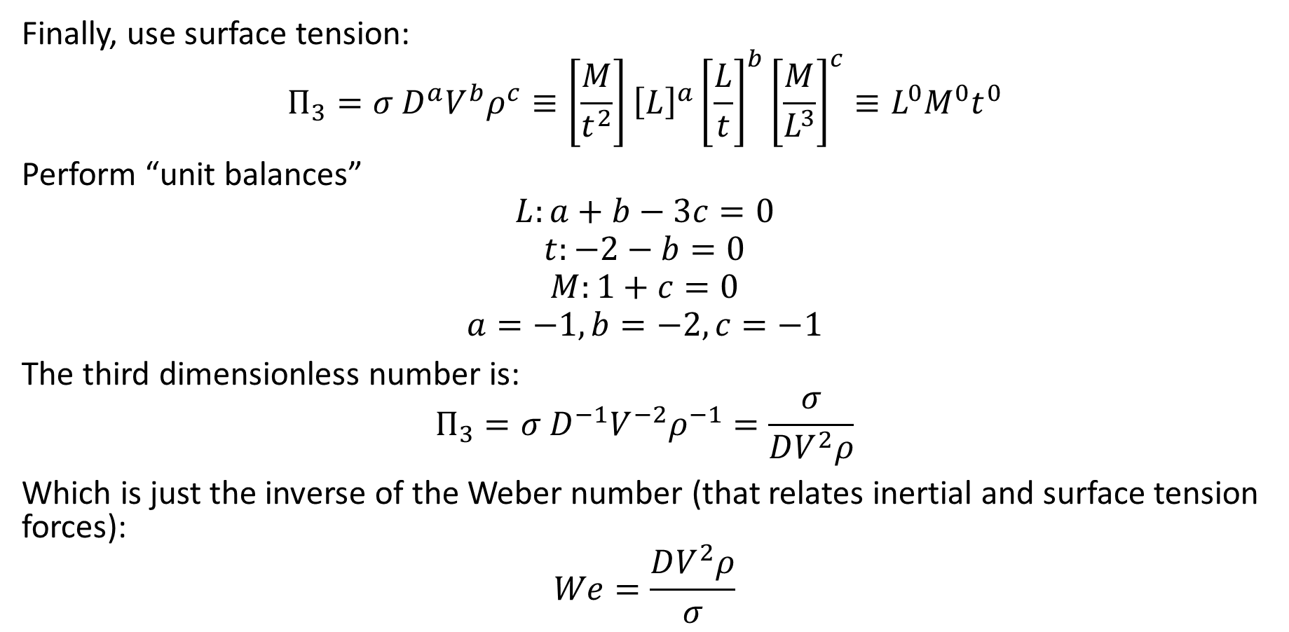
Dimensionless Numbers - Solution
Finally, use surface tension:
$$Π_{3}=σ D^{a}V^{b}ρ^{c}≡\left[\frac{M}{t^{2}}\right]{\left[L\right]}^{a}{\left[\frac{L}{t}\right]}^{b}{\left[\frac{M}{L^{3}}\right]}^{c}≡L^{0}M^{0}t^{0}$$
Perform “unit balances”
$$L:a+b−3c=0$$
$$t:−2−b=0$$
$$M:1+c=0$$
$$a=−1, b=−2, c=−1$$
The third dimensionless number is:
$$Π_{3}=σ D^{−1}V^{−2}ρ^{−1}=\frac{σ}{DV^{2}ρ}$$
Which is just the inverse of the Weber number (that relates inertial and surface tension forces):
$$We=\frac{DV^{2}ρ}{σ}$$

Slide 19
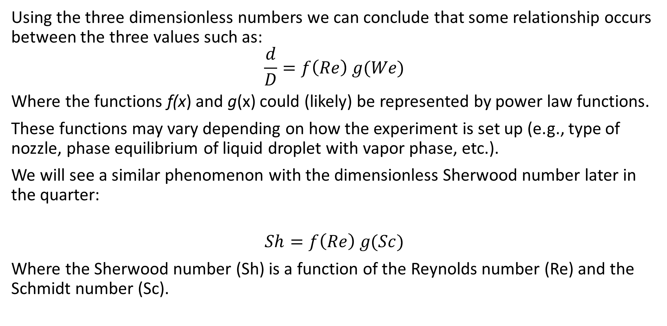
Dimensionless Numbers - Solution
Using the three dimensionless numbers we can conclude that some relationship occurs between the three values such as:
$$\frac{d}{D}=f\left(Re\right) g(We)$$
Where the functions f(x) and g(x) could (likely) be represented by power law functions.
These functions may vary depending on how the experiment is set up (e.g., type of nozzle, phase equilibrium of liquid droplet with vapor phase, etc.).
We will see a similar phenomenon with the dimensionless Sherwood number later in the quarter:
$$Sh=f\left(Re\right) g(Sc)$$
Where the Sherwood number (Sh) is a function of the Reynolds number (Re) and the Schmidt number (Sc).

Slide 20
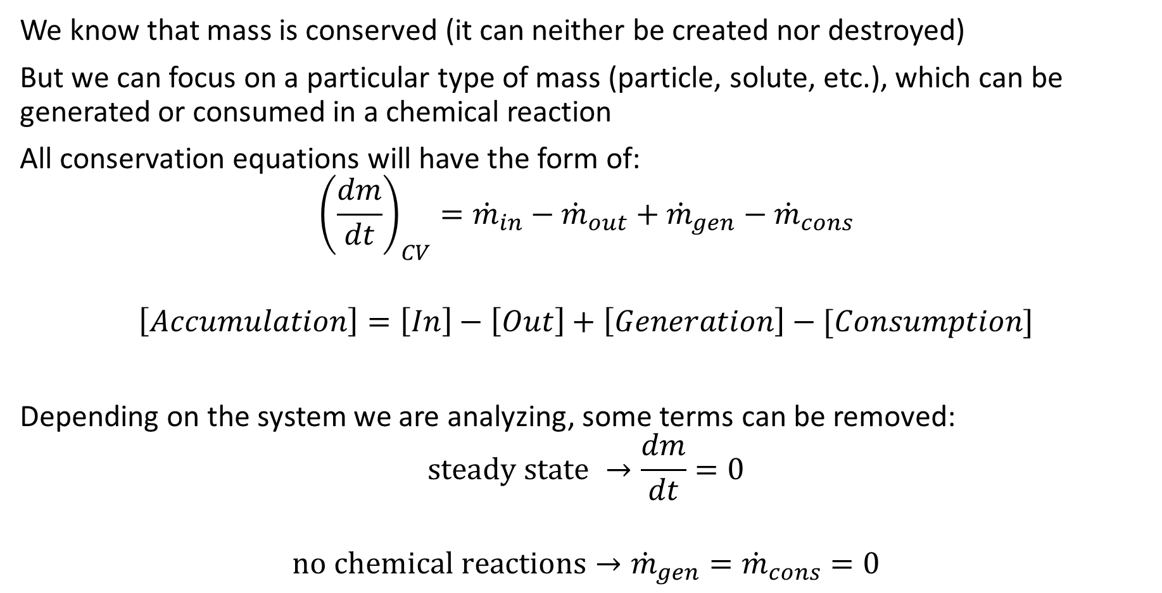
Conservation of Mass
We know that mass is conserved (it can neither be created nor destroyed)
But we can focus on a particular type of mass (particle, solute, etc.), which can be generated or consumed in a chemical reaction
All conservation equations will have the form of:
$${\left(\frac{dm}{dt}\right)}_{CV}={\dot{m}}_{in}−{\dot{m}}_{out}+{\dot{m}}_{gen}−{\dot{m}}_{cons}$$
$$\left[Accumulation\right]=\left[In\right]−\left[Out\right]+\left[Generation\right]−[Consumption]$$
Depending on the system we are analyzing, some terms can be removed:
$$\text{steady} \text{state} →\frac{dm}{dt}=0$$
$$\text{no} \text{chemical} \text{reactions}→{\dot{m}}_{gen}={\dot{m}}_{cons}=0$$

Slide 21
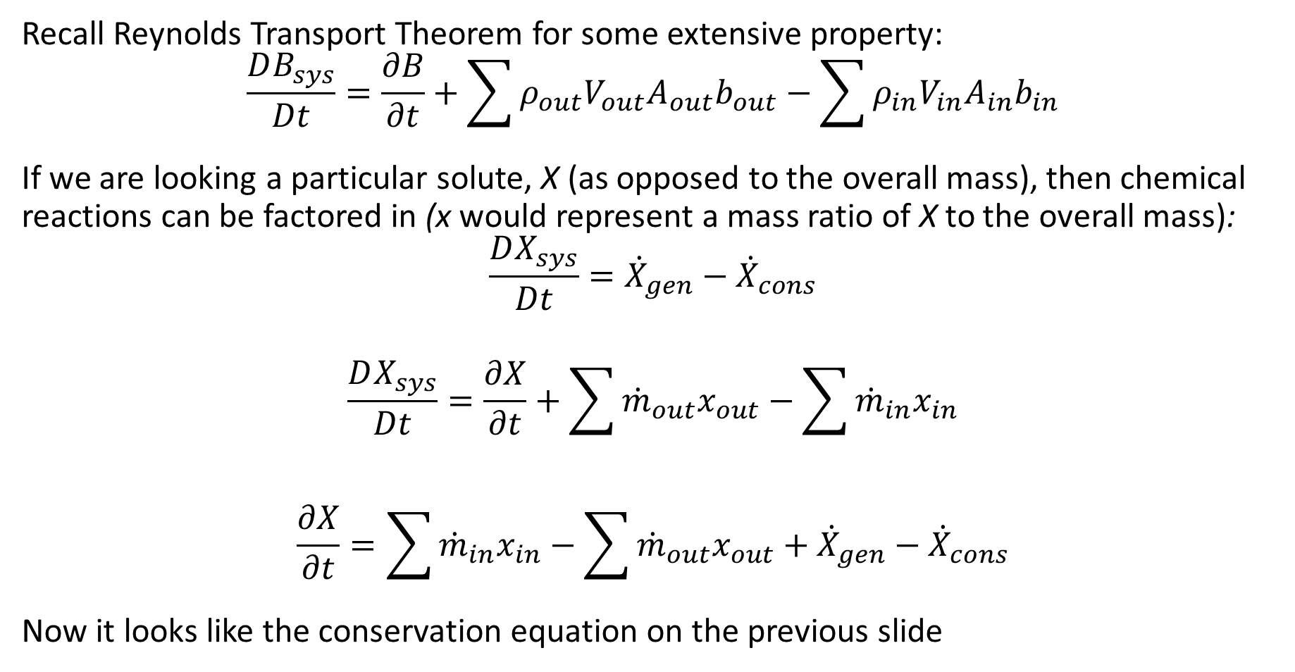
Reynolds Transport Theorem
Recall Reynolds Transport Theorem for some extensive property:
$$\frac{DB_{sys}}{Dt}=\frac{∂B}{∂t}+\sum{ρ_{out}V_{out}A_{out}b_{out}}−\sum{ρ_{in}V_{in}A_{in}b_{in}}$$
If we are looking a particular solute, X (as opposed to the overall mass), then chemical reactions can be factored in (x would represent a mass ratio of X to the overall mass):
$$\frac{DX_{sys}}{Dt}={\dot{X}}_{gen}−{\dot{X}}_{cons}$$
$$\frac{DX_{sys}}{Dt}=\frac{∂X}{∂t}+\sum{{\dot{m}}_{out}x_{out}}−\sum{{\dot{m}}_{in}x_{in}}$$
$$\frac{∂X}{∂t}=\sum{{\dot{m}}_{in}x_{in}}−\sum{{\dot{m}}_{out}x_{out}}+{\dot{X}}_{gen}−{\dot{X}}_{cons}$$
Now it looks like the conservation equation on the previous slide

Slide 22
Mass Balance - Problem
The glomerular filtration rate is an important measure of kidney function. A common method to determine glomerular filtration rate is to add a low molecular weight sugar, inulin, to the blood and measure its concentration in the blood and urine. Inulin is not reabsorbed into the blood after it has been filtered out in the glomerulus.
The plasma inulin concentration is found to be 1.5 mg/mL and the concentration in the urine to be 95 mg/mL. Determine the glomerular filtration rate using a urine production rate of 1.2 mL/min. Assume the renal artery blood flow rate is 1.32 L/min with a hematocrit level of 0.42 (percent cells by volume). Determine the filtration fraction which is the ratio of the glomerular filtration rate to the renal (arterial) plasma flow rate.
Compare this with the healthy filtration rate of about 110 mL/min and a filtration fraction of about 20%.

Slide 23


Mass Balance – Solution
Draw a picture if it helps:
If we assume the body behaves as a well-mixed system (and usually in this particular test the patient is receiving a continuous IV infusion of inulin), the exit concentration of inulin in the plasma will be the same as the inlet.
Kidney Glomerulus
& Bladder
Arterial Blood
$$Q_{a}=1.32\frac{L}{min}$$
$$H_{a}=0.42$$
$$C_{a}=1.5{\frac{mg}{mL}}^{∗}$$
*plasma concentration
Urine
$$Q_{u}=1.2\frac{mL}{min}$$
$$C_{u}=95\frac{mg}{mL}$$
Venule Blood

Slide 24
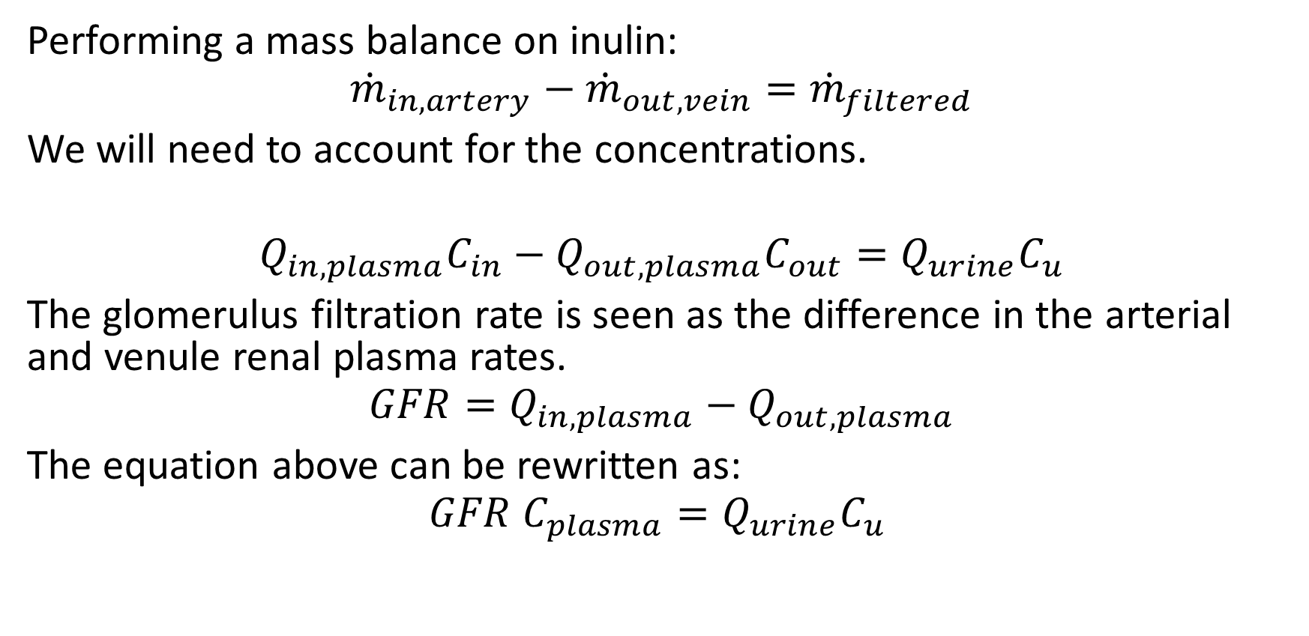
Mass Balance – Solution
Performing a mass balance on inulin:
$${\dot{m}}_{in,artery}−{\dot{m}}_{out,vein}={\dot{m}}_{filtered}$$
We will need to account for the concentrations.
$$Q_{in,plasma}C_{in}−Q_{out,plasma}C_{out}=Q_{urine}C_{u}$$
The glomerulus filtration rate is seen as the difference in the arterial and venule renal plasma rates.
$$GFR=Q_{in,plasma}−Q_{out,plasma}$$
The equation above can be rewritten as:
$$GFR C_{plasma}=Q_{urine}C_{u}$$

Slide 25
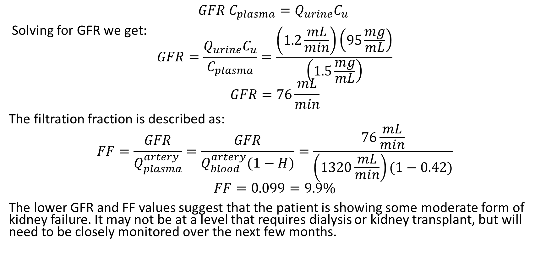
Mass Balance – Solution
$$GFR C_{plasma}=Q_{urine}C_{u}$$
Solving for GFR we get: $$GFR=\frac{Q_{urine}C_{u}}{C_{plasma}}=\frac{\left(1.2\frac{mL}{min}\right)\left(95\frac{mg}{mL}\right)}{\left(1.5\frac{mg}{mL}\right)}$$
$$GFR=76\frac{mL}{min}$$
The filtration fraction is described as:
$$FF=\frac{GFR}{Q_{plasma}^{artery}}=\frac{GFR}{Q_{blood}^{artery}(1−H)}=\frac{76\frac{mL}{min}}{\left(1320\frac{mL}{min}\right)(1−0.42)}$$
$$FF=0.099=9.9\%$$
The lower GFR and FF values suggest that the patient is showing some moderate form of kidney failure. It may not be at a level that requires dialysis or kidney transplant, but will need to be closely monitored over the next few months.

